Slide 1
Python: Lesson #6
Dictionary
By: Marc Geffroy

Slide 2
What was covered last week?
Python Project #01
Serial communications
Using your current knowledge
Controlling a mouse cursor
Refactoring code
Parsing byte and text

Slide 3
Data Structures
What is a data structure?
A way of formatting data so that it can be used by a computer program or other system
Why use data structures?
allow users and systems to efficiently organize, work with and store data

Slide 4
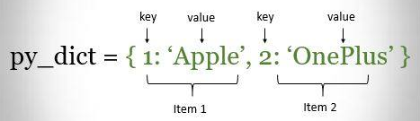
What is a dictionary?
It’s a collection of ordered (>v3.6) key value pairs
The keys are ordered.
Dictionary keys are unique.
Dictionary items are changeable

Slide 5

Dictionaries
Dictionaries are specified by curly braces ({ })
Similar to assigning a list
Optimised for retrieval of known items.
Item’s keys and values are separated by :.
Items are separated by a comma.

Slide 6
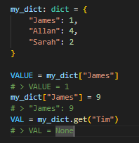
Accessing Dictionaries
Dictionaries items are accessed using their key.
You cannot access a dictionary using an index number like a list
You can set an item value using the key.
Safest way to access dictionary values is using get()

Slide 7
Other Dictionary methods
Pop(key) to delete specific key-value from a dictionary.
Update(key) adds or changes dictionary items.
Clear() removes all the items in a dictionary.
Keys() returns all the dictionary keys.
Values() returns all the dictionary values.
Get(key) returns the value specified by the key

Slide 8



Loops Using Dictionary

